Slide 1
Final Year Project Management System
Saqib Shehzad
2021-CS-187

Slide 2
Why we need this ?
1: Efficient management of student data:
With this system, the admin can easily manage student data, including information about their projects, advisors, and evaluations. This can help to streamline the administrative process, making it easier to keep track of all the relevant data in one place.
2:Improved project management:
This system allows the admin to create groups of students and assign projects to those groups, as well as assign advisors to the projects. This can help to ensure that students are working on appropriate projects with appropriate supervision, and that advisors are able to provide the necessary guidance and support.

Slide 3
Cont.
3: Better evaluation process:
This system also allows the admin to mark the evaluations of groups, which can help to ensure that students are receiving fair and consistent evaluations based on clear criteria. This can also help to identify areas where students may need additional support or guidance.
4: Increased transparency:
By keeping all relevant data in one place, your system can help to increase transparency and accountability. Students, advisors, and other stakeholders can easily access relevant information about projects and evaluations, helping to ensure that everyone is on the same page.

Slide 4
Features :
CRUD Operations:
The admin can perform Create, Read and Update operations on student, advisors, projects, and evaluations. This enables the admin to manage the data in the system.
Group Management:
The admin can create groups of students and assign projects to those groups. This feature allows the admin to manage the collaboration of students on projects.
Advisor Assignment:
The admin can assign advisors to projects, specifying their role in the project. This feature helps the admin to manage the guidance and supervision of advisors for student groups.
Evaluation Management:
The admin can mark the evaluations of groups. This feature enables the admin to assess the progress of the student groups in their projects.

Slide 5
Cont.
Database Connectivity:
The system is connected to a SQL database that stores all the data related to students, advisors, projects, and evaluations. This feature ensures that data is stored securely and can be retrieved easily.
User Interface:
The system has a user-friendly interface designed in C# windows form. The interface is intuitive and easy to use for the admin.
Reporting:
The system provides various reports related to students, advisors, projects, and evaluations. This feature enables the admin to monitor the progress of projects and the performance of students.

Slide 6
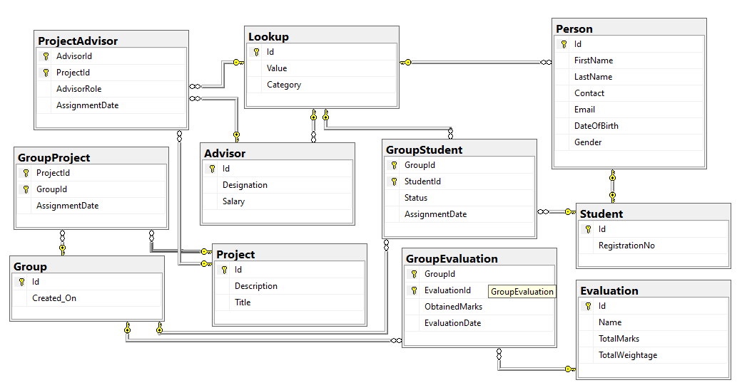
Database Diagram :

Slide 7
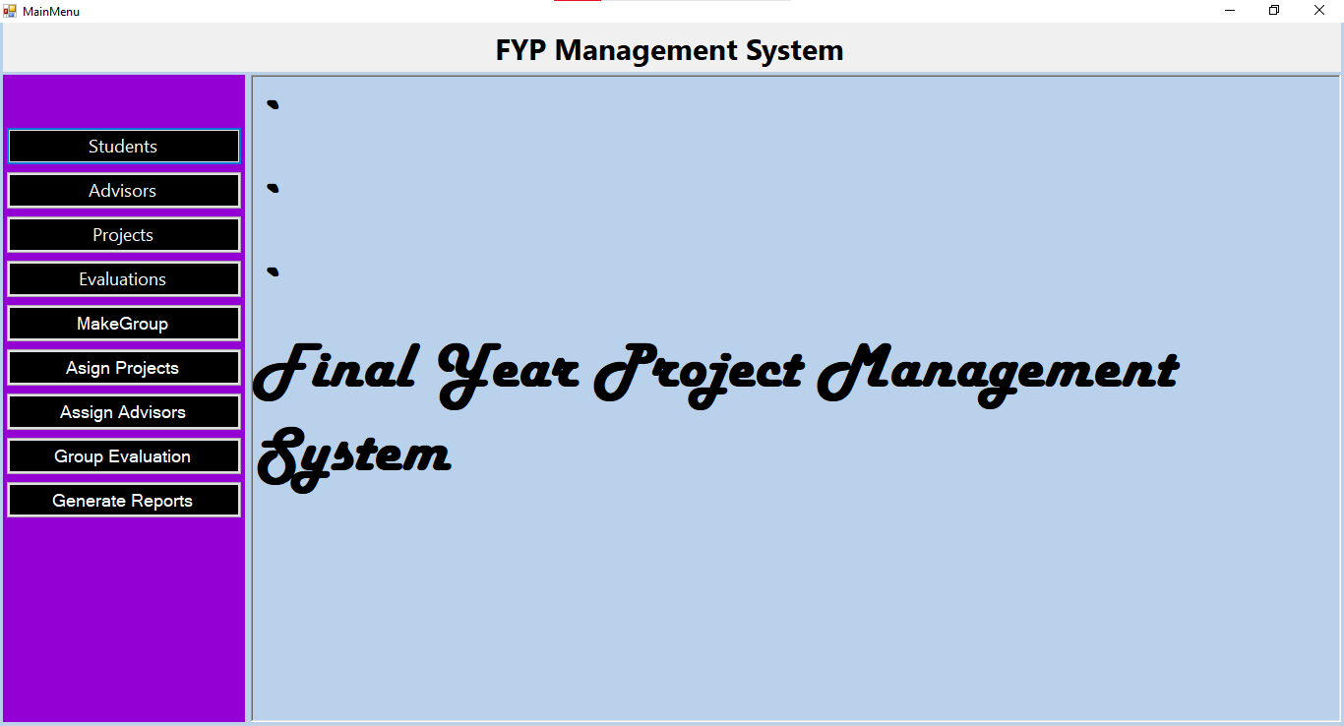
Main Menu :

Slide 8
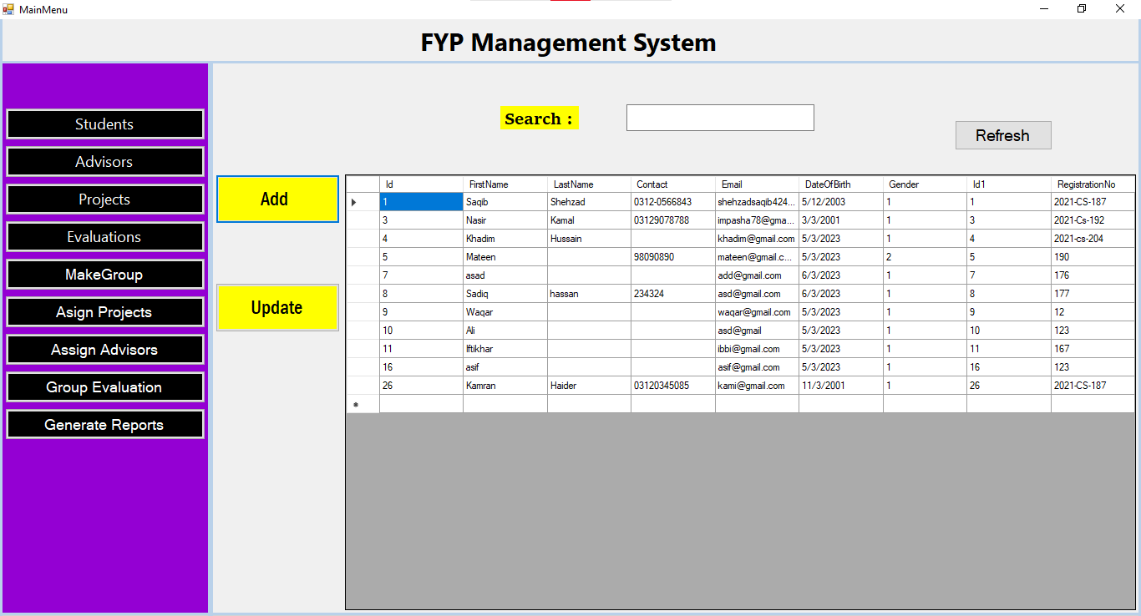
Manage Students :

Slide 9
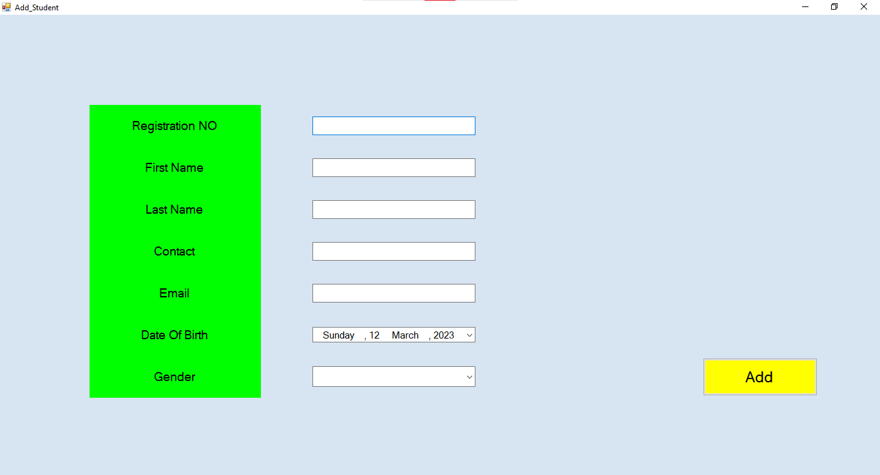
Add Student :

Slide 10
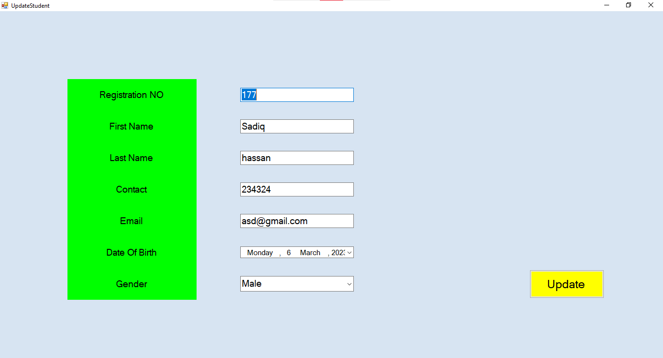
Update Student :

Slide 11
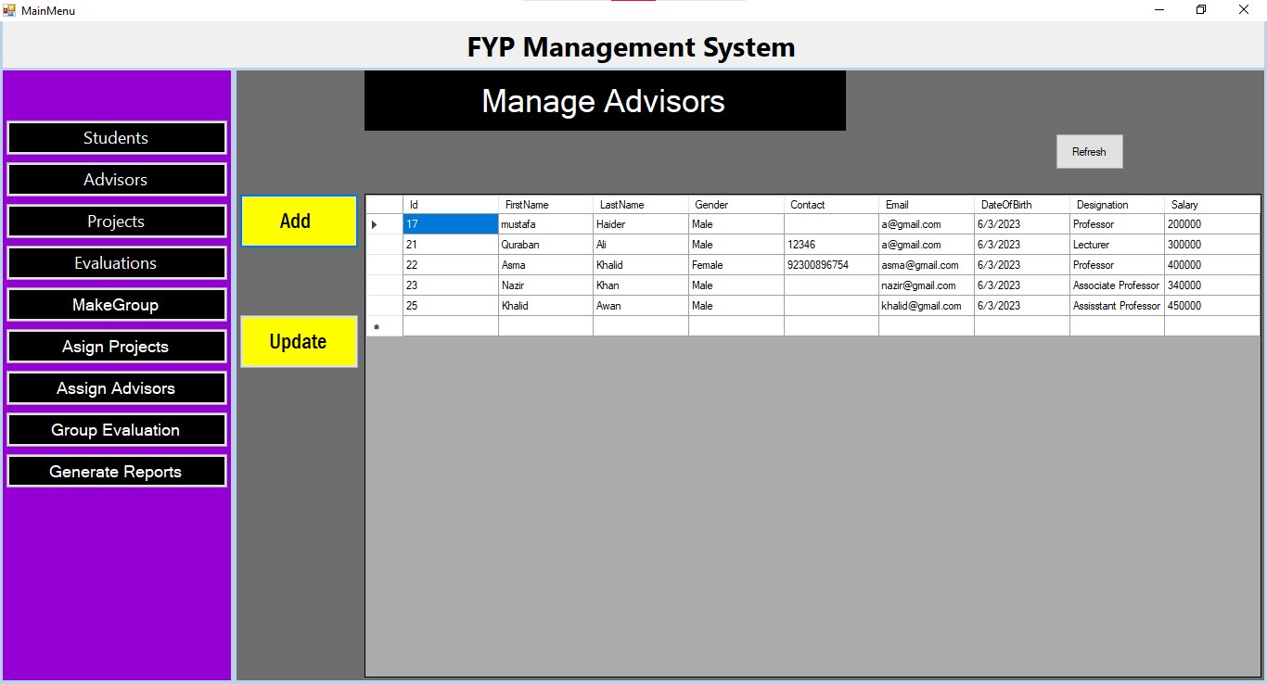
Manage Advisor :

Slide 12
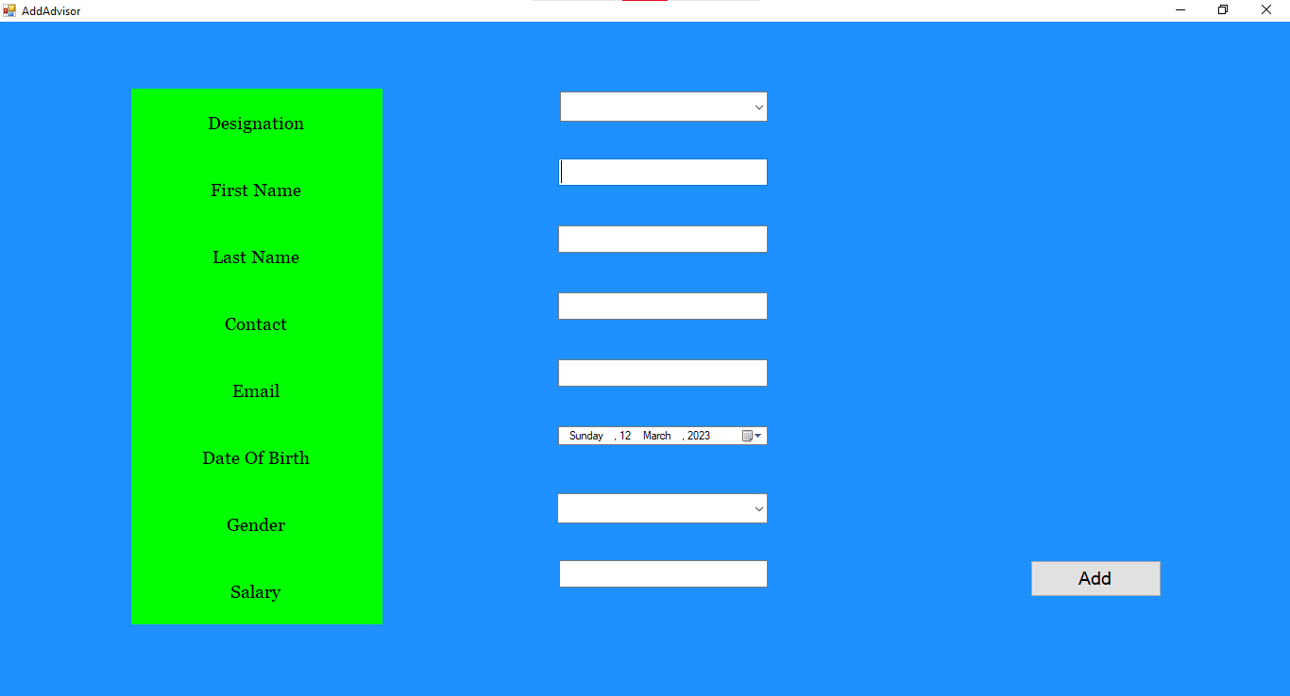
Add Advisor:

Slide 13
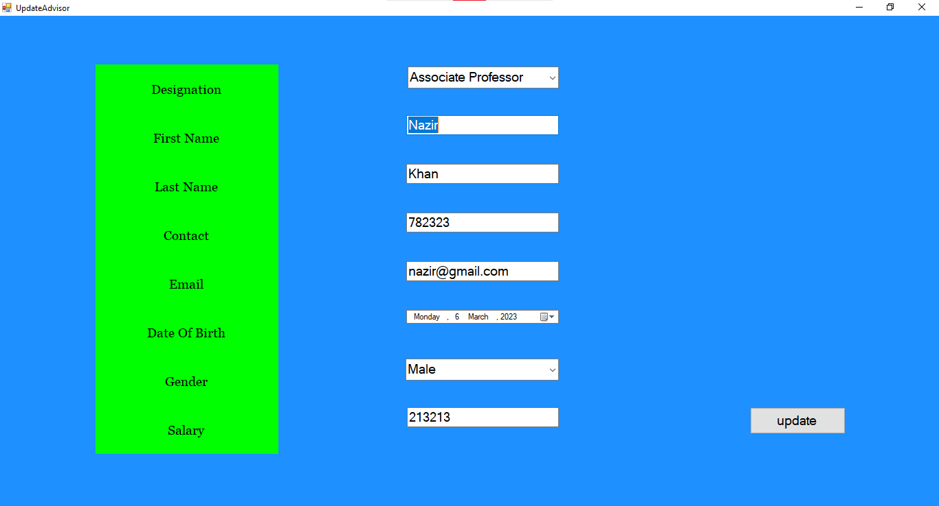
Update Advisor:

Slide 14
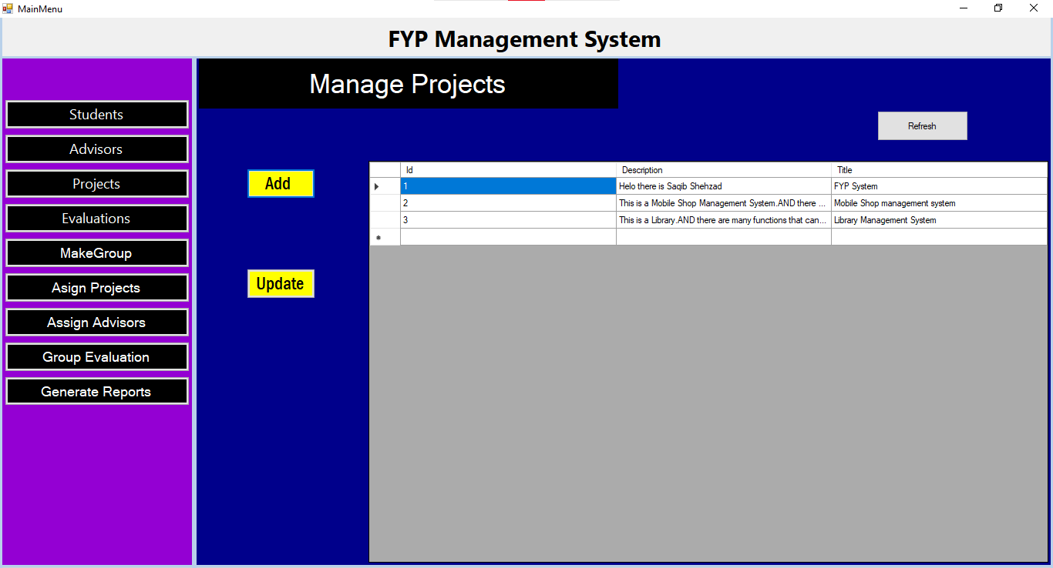
Manage Projects:

Slide 15
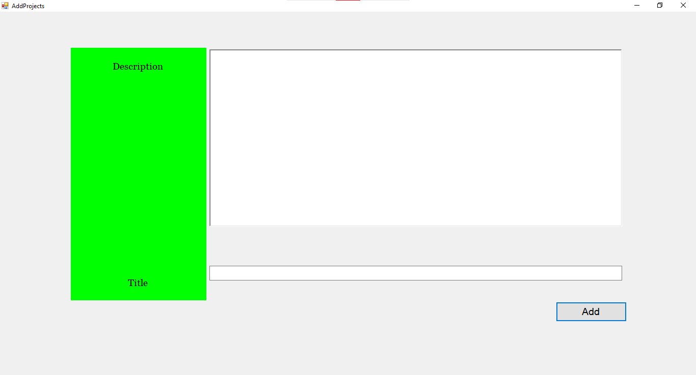
Add Projects:

Slide 16
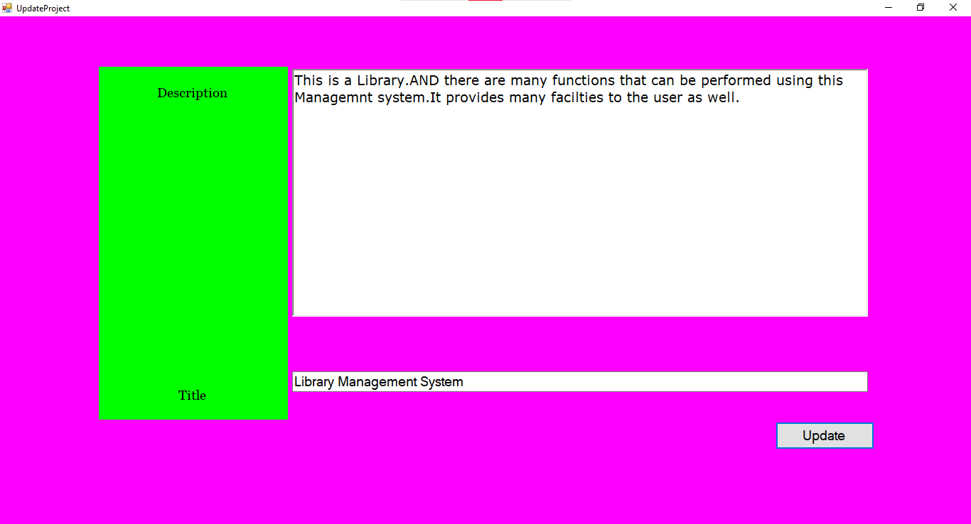
Update Projects:

Slide 17
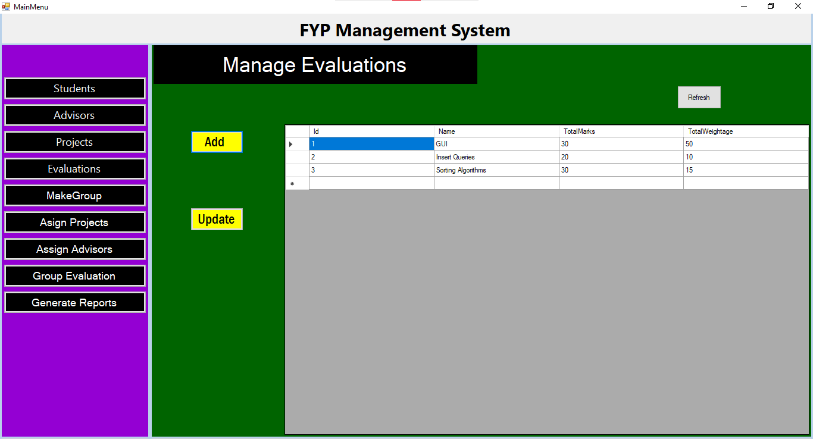
Manage Evaluations :

Slide 18
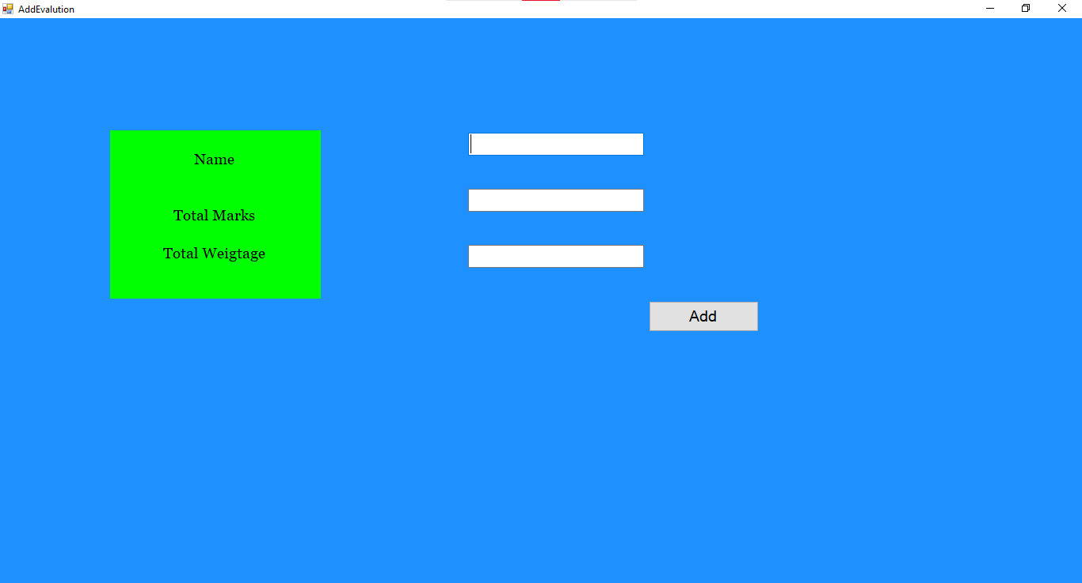
Add Evaluations:

Slide 19
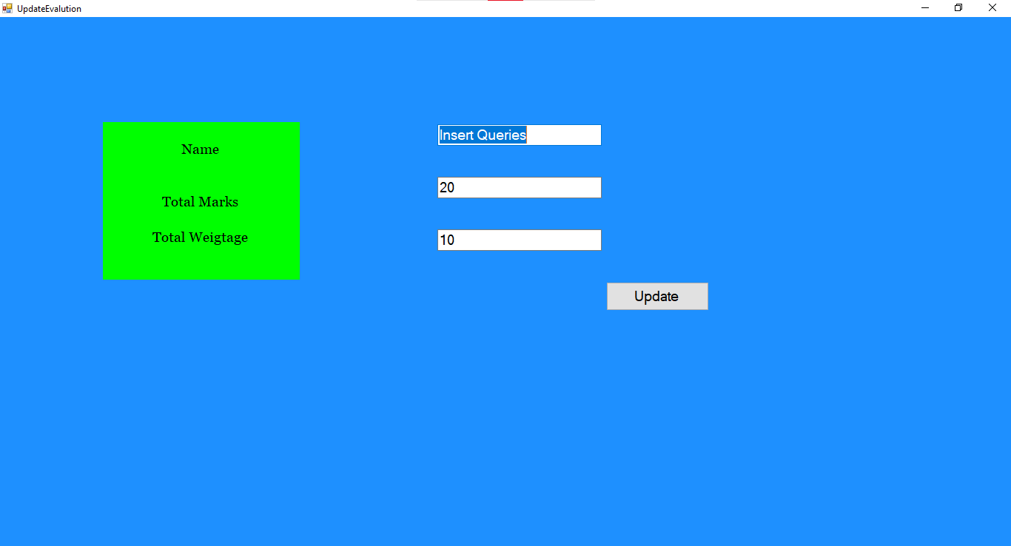
Update Evaluations:

Slide 20
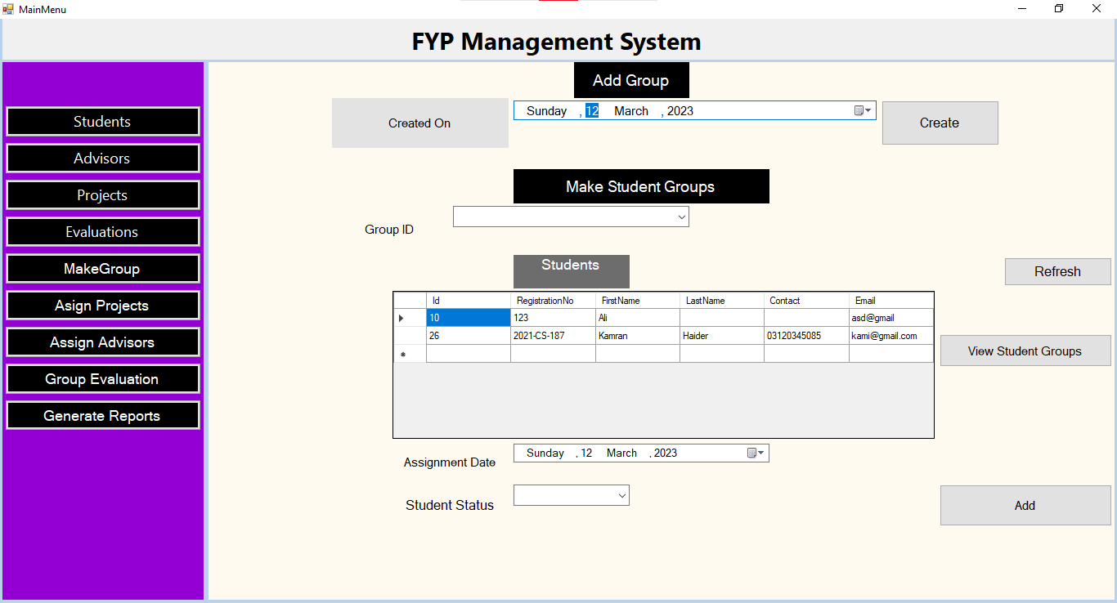
Create and Assign Groups:

Slide 21
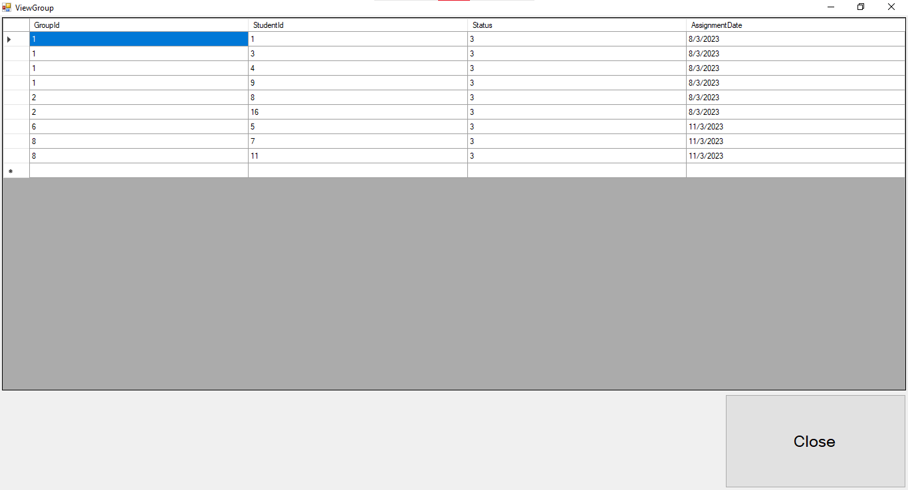
View Groups:

Slide 22
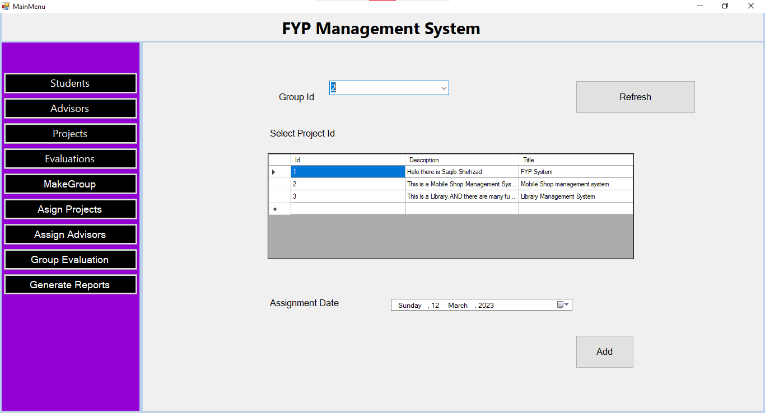
Assign Projects:

Slide 23
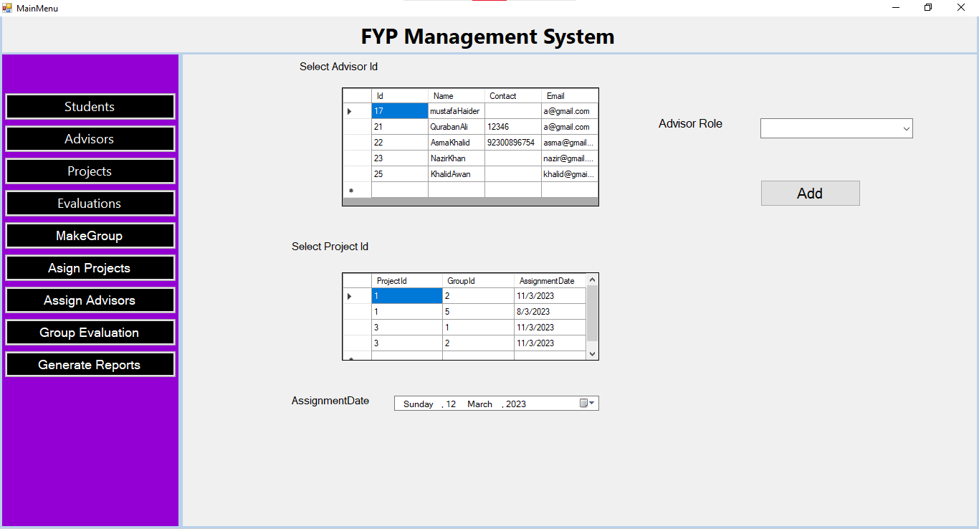
Assign Advisors :

Slide 24
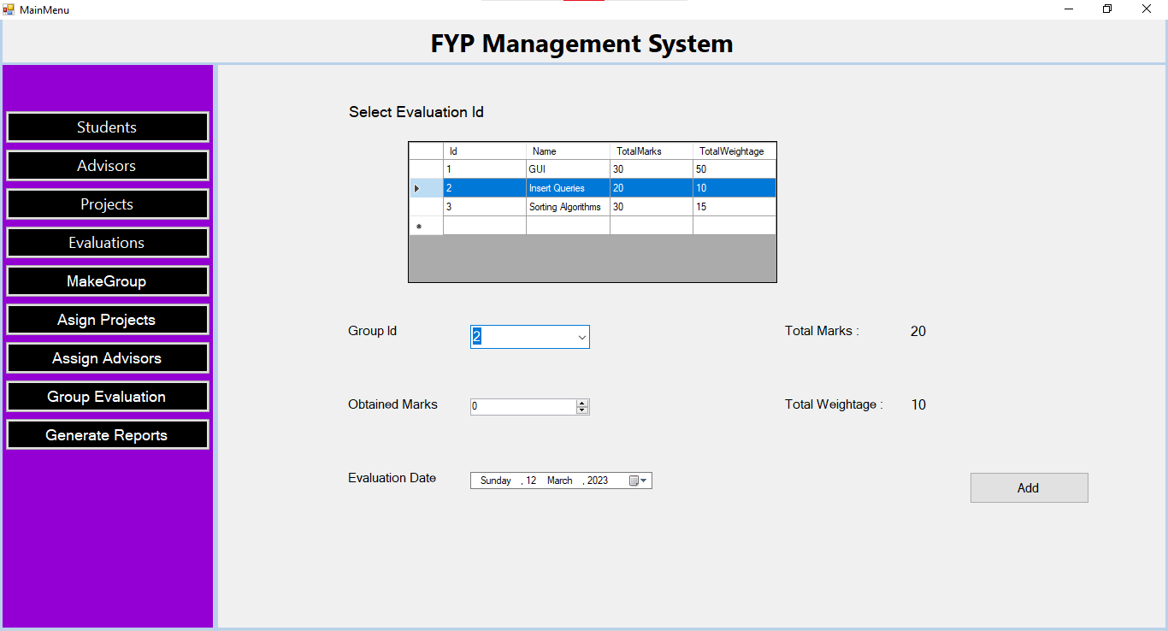
Group Evaluation :

Slide 25
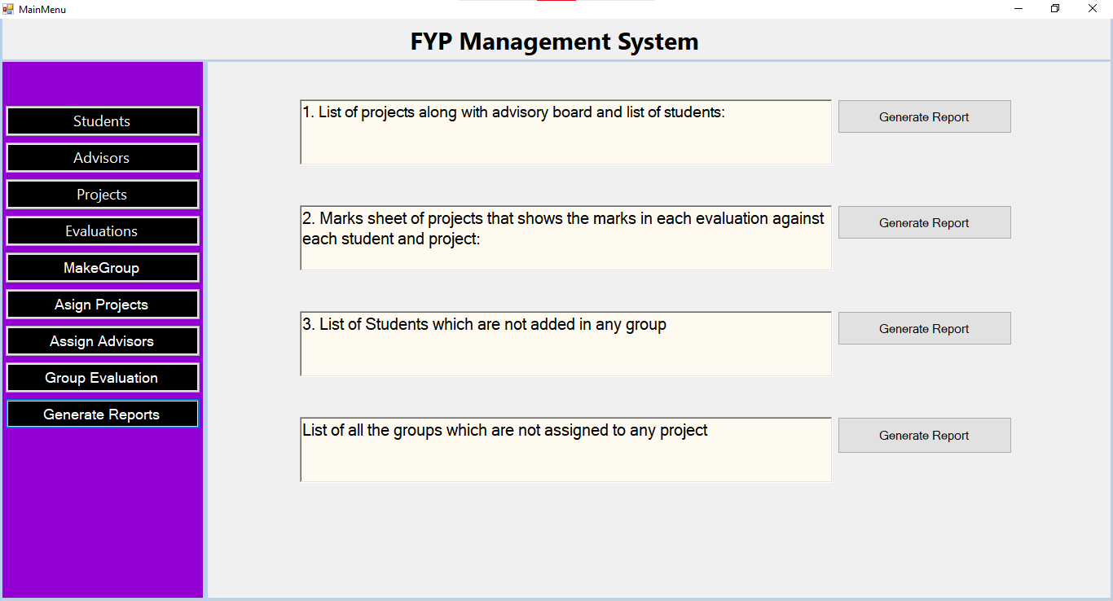
Generate Reports:

Slide 26
Limitations :
1: Limited User Access:
The system is designed to only allow one admin user to access and manage the data. This can be a limitation if there are multiple stakeholders who need to access or contribute to the project.
2: Lack of Collaboration:
While the system allows the admin to create groups of students, it does not provide any collaboration features such as real-time messaging or document sharing. This can be a limitation if the student groups need to collaborate closely on their projects.
3: Limited Functionality:
While the system covers the basic functions of project management and evaluation, it may not be suitable for more complex scenarios or special requirements. For instance, it may not support advanced analytics or integrations with other systems.
4: Security Risks:
While the system has some security measures such as user authentication and authorization, it may still be vulnerable to security risks such as data breaches or attacks. The system should undergo regular security assessments and updates to mitigate these risks.

Slide 27
Future Work :
1: Multiple User Roles:
Instead of having a single admin user, the system could be designed to support multiple user roles such as project managers, advisors, and students. This would allow for more collaboration and delegation of responsibilities.
2: Enhanced Collaboration:
The system could be upgraded to include features such as real-time messaging, document sharing, and task assignments to improve collaboration among student groups and advisors.
3: Integration with External Systems:
The system could be upgraded to integrate with other systems such as learning management systems, project management tools, and collaboration platforms to improve workflow and productivity.
4: Mobile App Support:
The system could be upgraded to include a mobile app that would allow students, advisors, and admin to access the system from their smartphones or tablets.
5: Improved Security:
The system could be upgraded to include more advanced security features such as data encryption, intrusion detection, and continuous security monitoring to protect against cyber threats

Slide 28
Conclusion :
In conclusion, the Final Year Management System is a promising project that
addresses the needs of managing student projects and evaluations in a centralized and efficient manner. The system provides essential features that simplify the process of creating, assigning, and evaluating student projects while ensuring data security.
Overall, this project is a powerful tool that has the potential to become even more effective with future upgrades and enhancements. By continuously evaluating the needs of the users and incorporating cutting-edge technologies, the system can continue to adapt and evolve to meet the ever-changing demands of academia.

